Slide 1
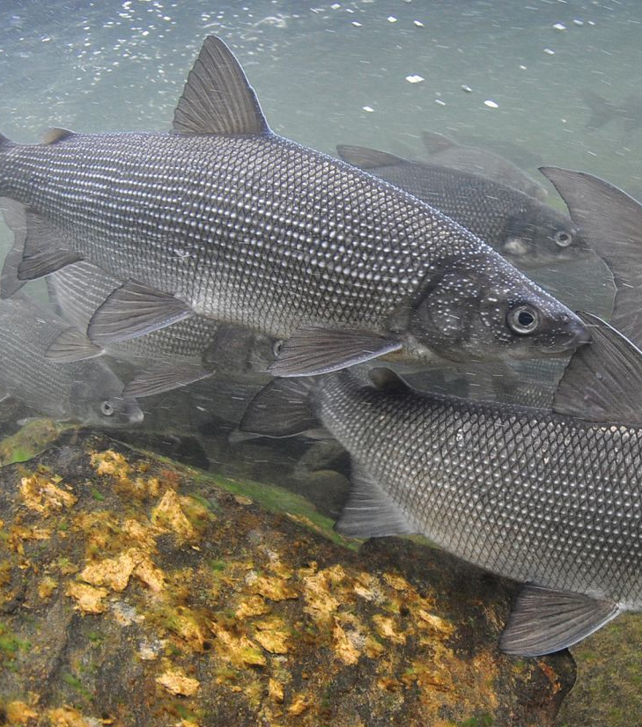
Larval Lake Whitefish (Coregonus clupeaformis) Morphology: A Multivariate Approach
Adam Harman – MSc Candidate
Mara McHaffie – MSc Candidate

Slide 2
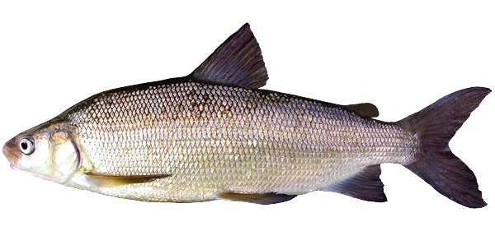
Study Species: Lake Whitefish
Cold-water adapted species
Found in all Great Lakes
Spawn on shallow cobble
Long embryonic incubation: November – March
Notes:
Lake whitefish are a cold-water species that can be found in the great lakes
They are somewhat unique as their embryos incubate over the winter when temperatures are very low, but stable

Slide 3
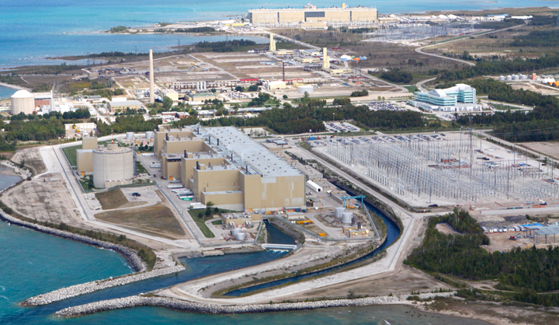
Thermal Effluents – Bruce Power
Many industrial power plants use “Once-through cooling”
Bruce Power nuclear reactors discharge heated effluent into potential Lake Whitefish spawning grounds
Joint research effort with McMaster to investigate impacts on developing fish
Notes:
Anthropogenic inputs like thermal effluent can disturb stable temperatures, increasing ambient temperature by about 3C
We tested fish at 2C (natural), 5C (effluent) and 8C (extreme)

Slide 4
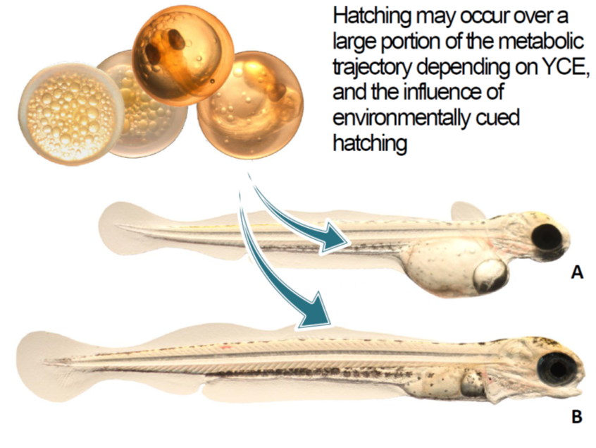
Dataset
Anterior Fin Width
Eye Diameter
High Incubation Temperature
= Early Hatching
Posterior Fin Width
Yolk Length, Width, Volume, Mass
‘Normal’ Low Incubation Temperature
= Later Hatching
Minimum Fin Width
Jaw Gape
Body Length, Mass
Notes:
They hatch much earlier with a distinct phenotype at 8C (images) – Because of this age is measured in days post hatch, instead of post-fertilization
To analyze the secondary effects on morphology we measured morphological features on the larvae that were underdeveloped at 8C – including the eyes, jaws, fins and yolk

Slide 5
Research Questions:
What is the influence of incubation temperature on fish size and morphology at different developmental stages?
How does incubation temperature influence the relationships between different morphological characteristics?
Can we use these relationships to reduce the number of measurements required in future studies?
What is the effect of incubation temperature on yolk use efficiency (i.e. relationship between growth rate and yolk depletion rate)?

Slide 6
Statistical Approach
Use correlation plots and model coefficients to investigate relationships between variables
Create 2 multivariate linear models that incorporates incubation temperature and age as predictors
Body morphology
Yolk measurements

Slide 7
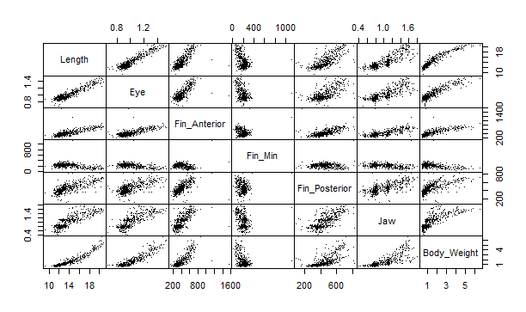

Slide 8
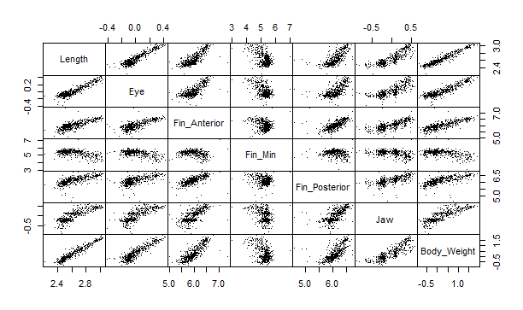

Slide 9
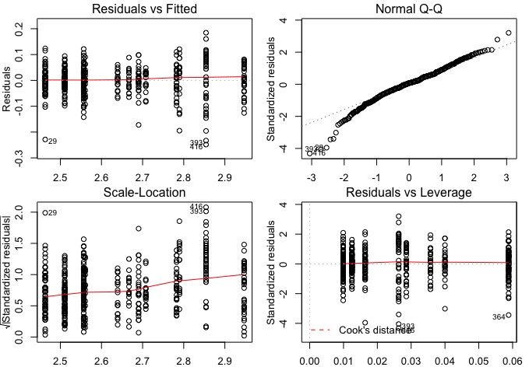
Diagnostic Plots - Length
Notes:
Adam – 11-13
Diagnostic plots are difficult to produce in multivariate statistics, as they incorporate multiple variables and can be difficult to interpret
Instead of using permutations or bootstrapping (suggested by Dr. Dworkin) we decided to tease apart the multivariate model, and create individual linear models to assess model assumptions
We made a linear model with each of our 7 response variables, and analyzed the diagnostic plots individually for each response

Slide 10
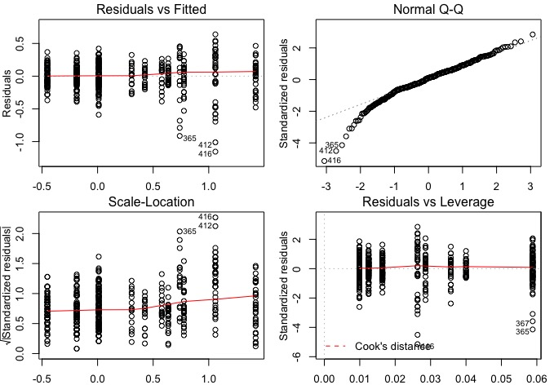
Diagnostic Plots – Body Weight
Notes:
Most of our models met the linear model assumptions, however did not meet the normality assumption (q-q plot) – least important of the plots?
We didn’t interpret any of our diagnostic plots as “alarming” so we continued to fit our multivariate linear model

Slide 11
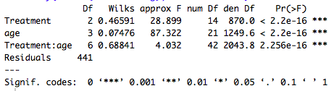
The multivariate linear model - morphology
Notes:
Here is the code that structured our multivariate model
We used the regular lm function, but input a matrix of our 7 response variables
My dataset contained two predictor variables of temperature treatment (2C, 5C, 8C) and Age (0, 7, 14, 28 days) – which were both treated as factors for this analysis (explain why???)
While they represent continuous variables, the data are discrete. The difference in effect from 2 -> 5 and 5 -> 8 are not equal, so it is better to consider them factors than numerics (similar for age) ---- is that right?

Slide 12
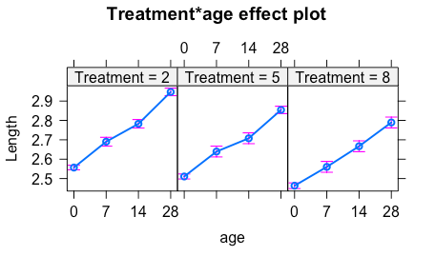
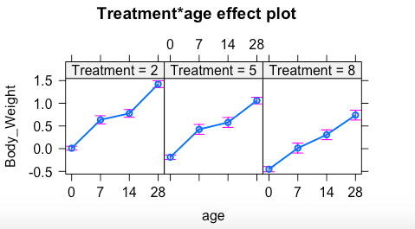
Effect Plots – Body Length and Mass
Notes:
Mara – 14-16

Slide 13
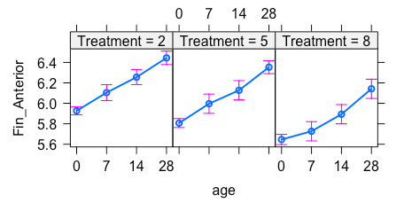
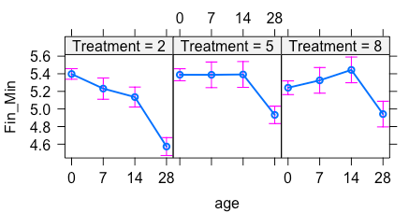
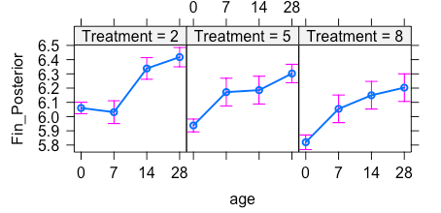
Effect Plots – Fin Measures

Slide 14
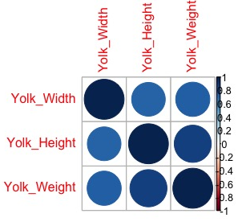
Issues – Yolk Size
Study design – lethal sampling
After 14 days dry weight is below detection level but still have a measurable yolk sac
Zero values at 7 days for some fish
Notes:
There are several confounds that make it difficult to analyze yolk morphology, mostly stemming from the study design
Sampling is lethal, so we cannot follow the same fish and measure yolk size
All fish after 14 days have 0g of yolk, but still have a measurable yolk sac (hard to remove after a certain point)
Some fish have 0g of yolk as early as 7 days, which makes log transforming tricky (have to scale them)
Interpreting the results is tricky, need a completely different study design if we really want to look at “yolk efficiency”

Slide 15
Next Steps:
How can we compare model coefficients statistically to see if temperature influences allometry?
Experiment with better ways of visualizing effects
Investigating relationship between body weight and yolk size

